Slide 1
Introduction to Windows Penetration Testing
Lesson 17.1
Cybersecurity
Lesson 16.1

Slide 2

Class Objectives
By the end of today’s class, you will be able to:
Discern the differences between Windows and Linux penetration testing.
Explain what ports a Windows machine commonly has open.
Explain how Windows authentication works.
Perform poisoning or spoofing attacks on a Windows network.

Slide 3

Windows
Penetration Testing

Slide 4
Windows Penetration Testing
We learned about penetration testing concepts, techniques, and the MITRE ATT&CK matrix. We performed a pen test on a single Linux machine.
We will expand the scope of our pen test to compromise a Windows domain that consists of a workstation and domain controller.
Previous week
This week
Next three days
We will continue with the MegaCorpOne scenario and re-perform the penetration testing cycle from the perspective of attacking a Windows machine.
We will learn techniques and tactics for compromising a Windows network and how to recognize the differences between pen testing Linux and Windows machines.

Slide 5
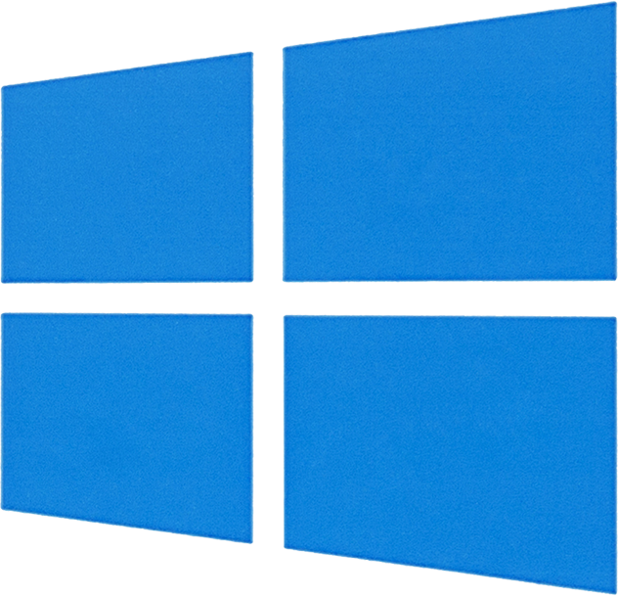

Windows vs. Linux Pen Testing
While it is important for penetration testers to be able to conduct tests against Linux machines, most enterprises use Windows Server to run their business.
Understanding and determining vulnerabilities within Windows systems is
an important skill for a penetration tester.
For Windows penetration testing, we’ll use many of the same tactics that we used
for Linux.
However, we’ll carry out these tactics with different techniques.

Slide 6
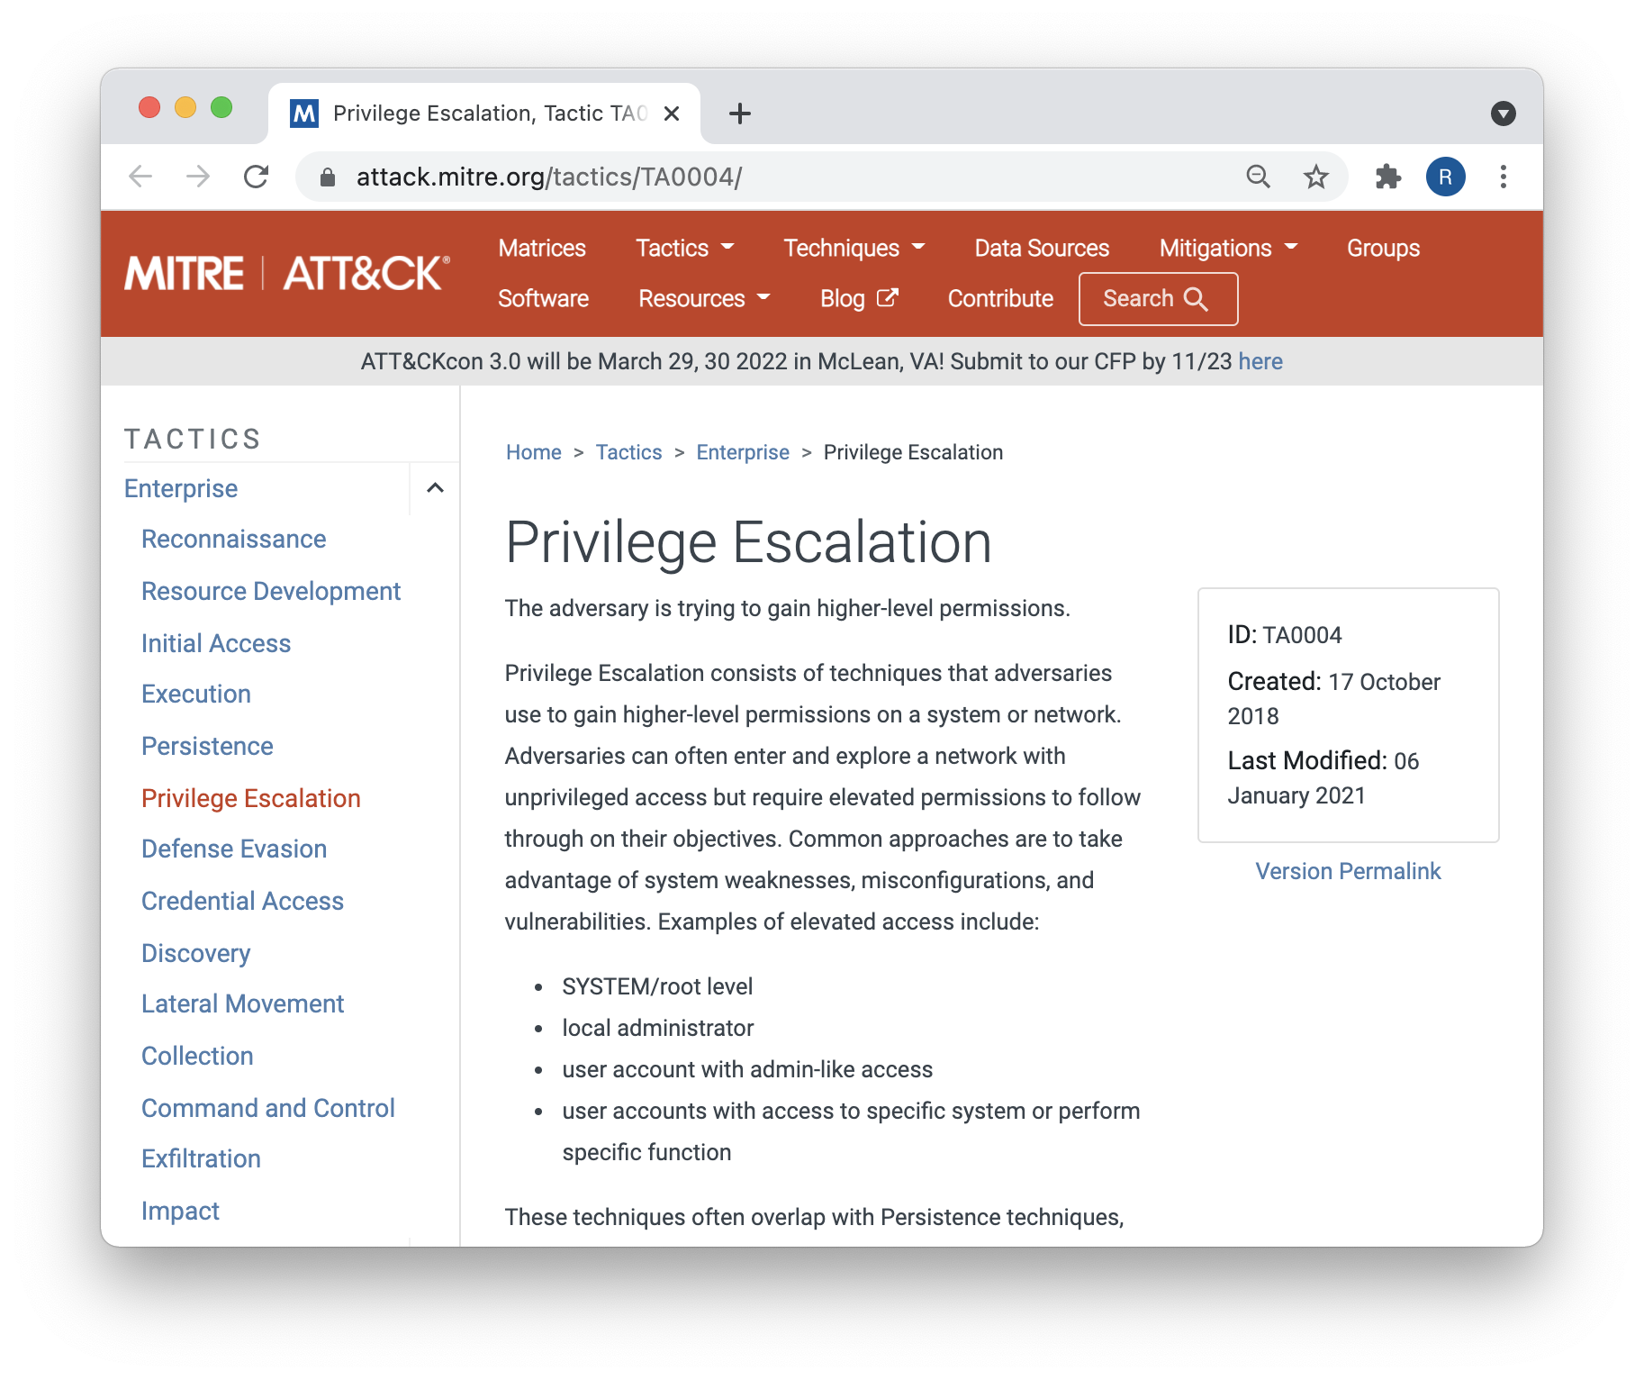
Tactics and Techniques
Remember that on the MITRE ATT&CK matrix, a tactic is a specific step in penetration testing. Examples of MITRE tactics are:
Reconnaissance
Initial access
Execution
Persistence
Privilege escalation

Slide 7

A technique is how a specific tactic is carried out.

Slide 8
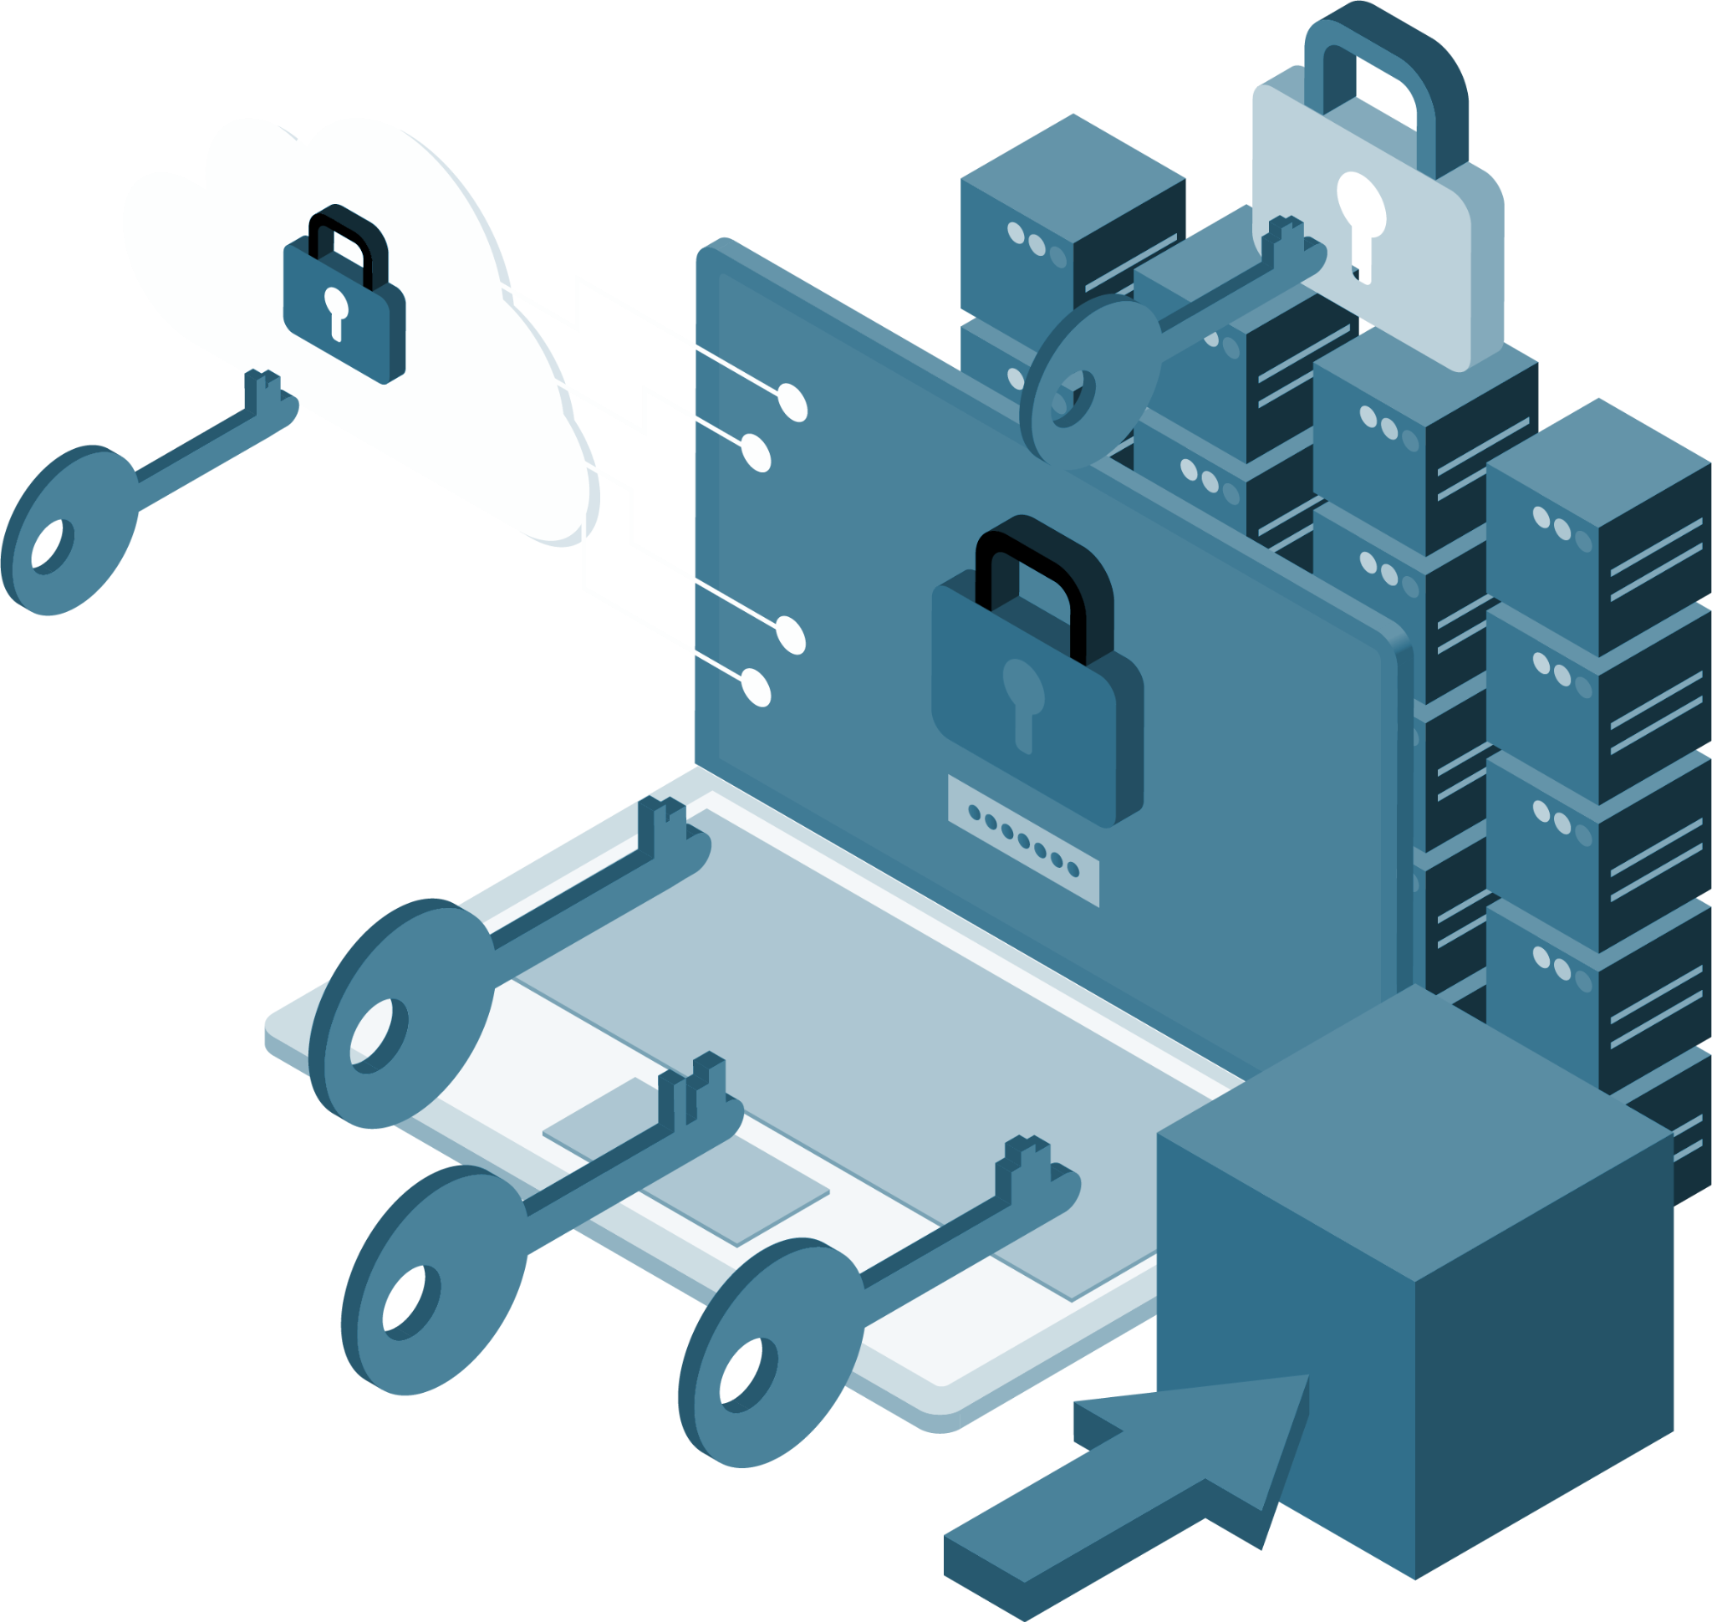
This Week
Since we’re familiar with penetration methodology, we’ll take an accelerated approach to the Windows pen testing stages this week.
Today we’ll cover:
01
Port scanning
02
Authentication
03
Password spraying
04
Protocol spoofing
05
Exploitation and initial access

Slide 9

This Week
At the end of
the week, you’ll continue the report you started in the last module.
Remember to continue taking notes and document
your findings.
We’ll continue using the same scenario for activities.

Slide 11

Linux, Windows,
Ports, and Protocols

Slide 12
Linux and Windows
By learning how to be a system administrator for either Linux or Windows machines, we’ve established a base for understanding how the operating systems are different and how to potentially identify weaknesses in each.
While pen testing, we’ll use this knowledge to exploit weaknesses in both systems.

Slide 13
How can a penetration test be different when facing Linux versus Windows?

Slide 14
Windows is much more prevalent
in corporate environments.
Because of Active Directory (AD), passwords are more reusable throughout a Windows network.
Ports and protocols
are very different.
Software and services are different, which introduces different potential exploits.
Authentication protocols
are different.
Permissioning is different
(e.g., no sudo in Windows).

Slide 15
Windows commonly uses different ports than Linux when operating in a network.

Slide 16
Ports and Protocols
Knowledge of some common ports can help differentiate a port scan’s results and inform the pen tester of what systems are on the network.
For example:
Port 22 (SSH) is a common port
to find open on a Linux machine.
It’s the protocol that is used for remotely accessing and administrating Linux.
Windows does not natively have SSH
as an installed service.
Instead, it relies on other protocols
such as SMB (port 445) and
Remote Desktop Protocol (RDP,
port 3389) to be remotely accessed.
Port 80 | HTTP | Sending web traffic
Port 443 | HTTPS | Sending encrypted web traffic
Port 21 | FTP | Sending files
Port 22 | SSH | Securely operating network services
Port 25 | SMTP | Sending emails
Port 53 | DNS | Translating domains into IP addresses
Port 445 | SMB | Accessing files on remote servers
Port 3389 | RDP | Connecting to remote machines

Slide 17
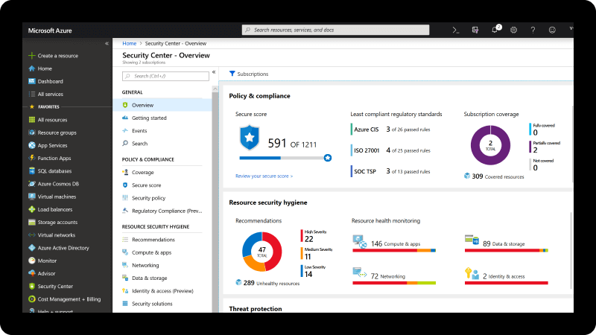
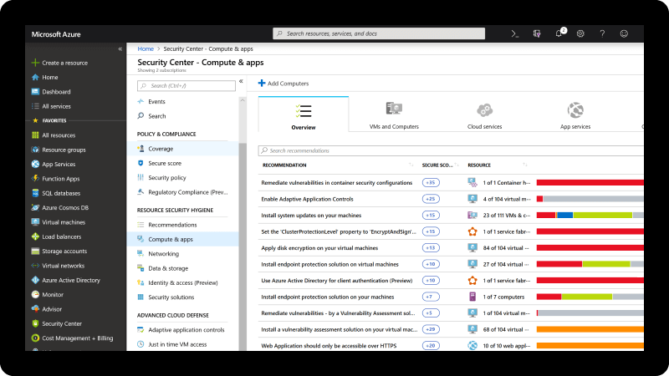
Ports and Protocols
An overwhelming majority of enterprises use Windows AD for directory services, which includes the administration of users, computers, and policies.

Slide 18

Ports and Protocols
AD needs several ports open to properly communicate between the domain controller (DC) and workstations on the network.
When a change is made
to a group policy in AD, workstations on the network that are connected to
AD reach out to the DC over ports 445 and 135 to retrieve the group policy update.
Kerberos, the primary form
of authentication in AD, uses port 88.
RPC (135)
Used for process
communication
SMB (445)
Commonly used
for sharing files
Workstation
DC
Kerberos (88)
Used for authentication

Slide 19
Port scanning
In this activity, you will continue your engagement with MegaCorpOne. Now that you’ve compromised a Linux server on the internal network, you will focus on Windows machines.
You’ll begin with a port scan.
10 minutes

Slide 22
Windows Authentication and Password-Based Attacks

Slide 23

Before performing an attack on a Windows machine, it’s important to understand how authentication works in Windows.
We’ll review
it now.
Notes:
shutterstock_488480038

Slide 24

Windows Authentication
There are two primary types of authentication in Windows:
01
Kerberos
02
NTLM
Kerberos is the default protocol for authentication in Windows and is heavily used in AD.
If Kerberos authentication is not possible, then Windows falls back to NTLM.

Slide 25
Windows New Technology LAN Manager (NTLM) is a “challenge-response” protocol and uses a three-step method:
Kerberos vs. NTLM
01
02
03
Negotiation message from the client
Challenge message from the server
Authentication message from
the client

Slide 26


NTLM Authentication
 | The user shares their username, password, and domain name with the client.
 | The client develops a scrambled version of the password—a hash—and deletes the full password.
 | The client passes a plain-text version of the username to the relevant server.
 | The server replies to the client with a challenge, which is a 16-byte random number.
 | In response, the client sends the challenge encrypted by the hash of the user’s password.
 | The server then sends the challenge, response, and username to the DC.
 | The DC retrieves the user’s password from the database and uses it to encrypt the challenge.
 | The DC then compares the encrypted challenge and client response. If these two pieces match, then the user is authenticated and access is granted.
1
5
2
6
3
7
4
8
1
2
3
Server
4
5
6
Client
8
7

Slide 27


Kerberos Replacing NTLM
NTLM was replaced by Kerberos in Windows 2000 and beyond due to several insecurities.
NTLM password hashes were not salted, meaning that a random string of characters was not added to the hashed password to further protect it from cracking techniques.
Plain Text
Add Salt
hello
hello3ab9
Hash Function
3
a
9
This meant that NTLM passwords could easily
be brute-forced.
b
Store Hash
and Salt

Slide 28
Kerberos differs from NTLM by using a ticketing system instead of a three-step method.

Slide 29
Kerberos vs. NTLM
1
The user sends a message to the DC with the ID of the user, the ID of
the requested service, and the client net address (IP).
This message is encrypted with the password hash of the user and a timestamp. The message is sent in the form of an AS-REQ (authentication service request).
2
The DC, also known as the key distribution center (KDC), receives the user's request and checks the username. It looks up the user’s password hash and attempts to decrypt the message using the password hash.
If it successfully decrypts the message, it knows the user supplied the correct password.
3

Slide 30
Kerberos vs. NTLM
4
The DC then responds to the message with a Ticket Granting Ticket (TGT). This TGT is proof that the user is who they say they are.
5
This response is called the AS-REP (authentication service reply).
.

Slide 31

Authenticating to the Domain in Kerberos
Yep, if your password hash matches what’s in my database, I’ll encrypt and verify the request.
I want to log in. Can you send me a TGT? I’m sending a request encrypted with my password hash and timestamp.
AS-REQ
Workstation
KDC
Thanks!
It’s a match!
Here’s your TGT.
AS-REP
Workstation
KDC

Slide 32

Kerberos and NTLM
Usually…
01
Kerberos
02
NTLM
Kerberos authentication is used for domain accounts.
NTLM authentication is used for local accounts.
This is because normal Windows workstations and non-DC servers are not KDCs and thus cannot process Kerberos tickets.

Slide 33
Password-Based Attacks

Slide 34

Since local
accounts use NTLM authentication,
it’s possible to guess passwords for a
local account without having to interact
with any DCs.
Notes:
shutterstock_1802004688

Slide 35
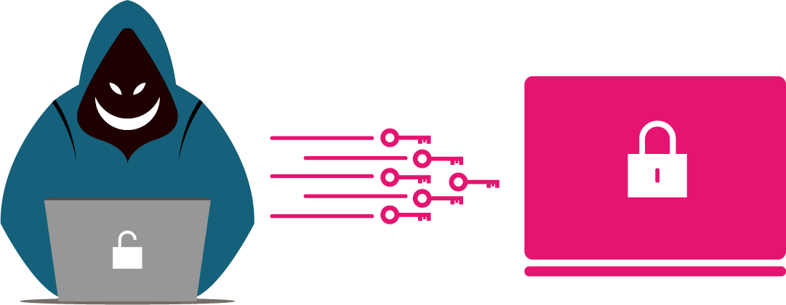
Password-Based Attacks
Local passwords are stored in the Security Account Manager (SAM) database. When a local user tries to authenticate to their own computer, the computer issues and verifies the challenge to check the password instead of a different machine.
This lets an attacker brute-force or
attempt to log in to
an account by trying multiple passwords.

Slide 36
What potential problem could a pen tester run into when attempting to brute-force passwords?

Slide 37
Local accounts, by default, do not disable an account from logging in due to a bad password.
The Risk of Brute-Force Attacks
1
However, events are still generated by Windows for each failed login attempt, even for local accounts.
2
If a blue team member is monitoring these logins, it’s very apparent when an attack is occurring.
3
We will investigate this type of attack from a blue team perspective later in the course.

Slide 38
Password Spraying
Successfully brute-forcing a domain account in Windows is less likely due to a default group policy that locks an account after five bad password attempts.
Instead, for domain accounts (which use Kerberos), password spraying is a more common attack.
msmith
awright
passw0rd1!
dwilliams
bkennedy

Slide 39
Password spraying involves getting a list of usernames and attempting a single password for those accounts.

Slide 40
Can you think of any common passwords that might be useful in a password spray attack?

Slide 41
Common Passwords
1
SeasonYear (e.g., Spring2021)
2
Any variation of the word “password”
3
PresidentYear
4
LetMeIn
5
ILoveYou

Slide 42
Recap: Linux vs. Windows Pen Testing
Let’s review what we’ve covered so far:
1
Windows and Linux penetration tests employ similar methodologies.
The difference between Linux and Windows pen testing is the techniques used to achieve tactics.
2
3
A tactic is a specific step in penetration testing.
4
A technique is how a specific tactic is carried out.

Slide 43
Let’s review what we’ve covered so far:
Recap: Windows Active Directory
Enterprises that use Windows often employ Windows AD for directory services such as the administration of users, computers, and policies.
1
AD needs several ports open to properly communicate between the DC and workstations on the network.
2
AD requires port 445 (SMB) and port 135 (RPC) in order to
work properly.
3

Slide 44
The two primary types of authentication in Windows are NTLM and Kerberos.
Recap: Windows Authentication
NTLM, a "challenge-response" protocol that works in three steps,
is used primarily for local accounts.
1
Kerberos, a protocol that uses a ticketing system for authentication,
is primarily used for domain accounts.
2
Kerberos is the default protocol for authentication in Windows and
is heavily used in AD.
3
If Kerberos authentication is not possible, then Windows falls back
to NTLM.
4

Slide 45
Let’s review what we’ve covered so far:
Recap: Attacking Accounts
Brute-force attacks are password attacks used against
local accounts.
1
Password spraying is a password attack used against
domain accounts.
2
Password spraying involves getting a list of usernames and attempting a single password for those accounts.
3

Slide 46
Password spraying
Now that you’ve determined which machines on MegaCorpOne’s network are Windows machines, you will perform your first attack: password spraying.
20 minutes

Slide 49
LLMNR Poisoning

Slide 50
There’s another way to get credentials for a domain account without brute-forcing or password spraying…

Slide 51
Link-Local Multicast Name Resolution (LLMNR) is an older broadcast protocol that serves as a local backup for DNS.

Slide 52
LLMNR Poisoning
Since LLMNR is a broadcast protocol, a request is sent out to the entire network rather than to a single host.
1
2
LLMNR is an older protocol that is left on in the default group policy.
Attackers can take advantage of this protocol by listening for LLMNR request broadcasts on the network and spoofing (faking) a response
to the request, asking for the requesting computer to complete a
password challenge.
3

Slide 53
LLMNR Poisoning
01
The attacker listens for LLMNR requests on the network.
02
A Windows machine user tries to visit a network share that
doesn't exist or makes a typo trying to visit an existing one.
03
The victim’s computer asks the DNS server if it knows where the network share is.The server responds with a share not found.
I need to access \\fileshrae01,
do you know where it is?
No.
Workstation
DNS Server

Slide 54
LLMNR Poisoning
04
The user’s computer then sends an LLMNR broadcast to the entire network, asking if any machines know where the file share is.
Does anyone know
where \\fileshrae01 is?
DNS Server
Workstation

Slide 55

LLMNR Poisoning
05
The attacker receives this request and responds by asking
the computer to encode a challenge with the user’s password.
Does anyone know
where \\fileshrae01 is?
DNS Server
Yes, I do, but before I tell you, encode
this challenge with your password hash.
Workstation

Slide 56
LLMNR Poisoning
06
Once the attacker receives the challenge encoded with the password, it responds to the computer with an error, which ends the communication. The attacker now has the victim’s password, which they can crack offline.
No problem.
Here you go.
DNS Server
Thanks. By the way: ERROR.
Workstation

Slide 58
LLMNR is a broadcast protocol, meaning an LLMNR request is sent out to the entire network instead of going to a single host.

Slide 59
Recap: LLMNR Poisoning
LLMNR poisoning is a way of getting credentials to a domain account without the need for brute force or password spraying. It involves taking advantage of the LLMNR protocol, which is left on in the default group policy.
Attackers can take advantage of this protocol by:
01
Listening
02
Asking
Listening for LLMNR request broadcasts on the network and spoofing a request response.
Asking for the requesting computer to complete a password challenge.

Slide 60
LLMNR spoofing
In this activity, you’ll perform LLMNR spoofing to retrieve a set of credentials for a domain user, which you will crack offline with John the Ripper.
20 minutes

Slide 63
Windows Exploitation
and WMI

Slide 64
Windows Exploitation
Exploitation for Windows is similar to exploitation for Linux.
In order to compromise a Windows machine, we will exploit any vulnerable services on the system and leverage legitimate tools and services for Windows.

Slide 65
WMI
The first tool we’ll use is Windows Management Instrumentation (WMI), a Microsoft tool created with the intention of remotely administering Windows machines.
Similar to how most Linux machines are managed over SSH, Windows machines can be managed remotely via WMI.
WMI operates over RPC, which is port 135.
Because WMI operates on port 135, which is also used for communication for AD,
a port scan against the Windows machine does not show the service WMI on port 135, as WMI simply leverages the RPC protocol on that port for communications.
WMI is a default-installed tool on Windows.

Slide 66
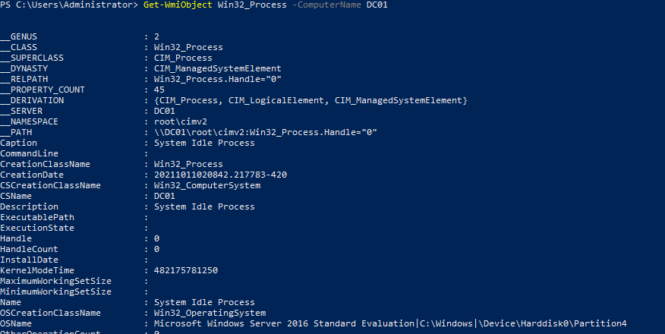
WMI Demo
Let’s explore how WMI is intended to work.

Slide 67
WMI

Slide 68
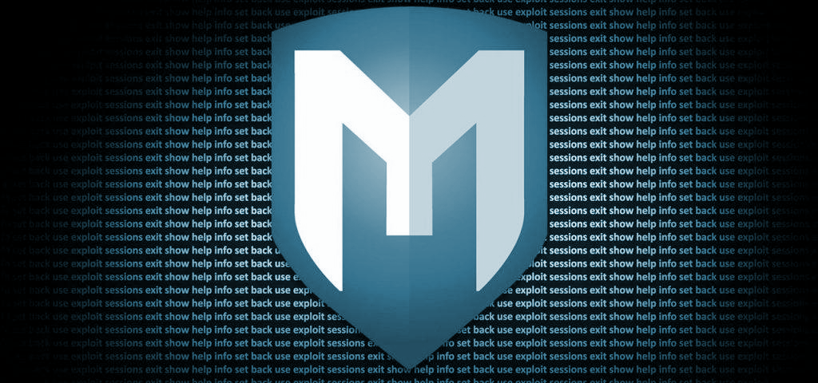
Now that you understand how WMI normally operates, we will use the Metasploit module and WMI to run commands remotely on the target machine.
Notes:
Image source: shutterstock_393006970

Slide 69
135 (RPC)

Slide 70
Windows exploitation
In this activity, you’ll leverage the credentials you found
in previous activities and use a Metasploit module to run commands on the remote machine.
15 minutes

